Slide 1
Chapter 12 Text IO
Sections 12.10-12.11

Slide 2
Objectives
To discover file/directory properties, to delete and rename files/directories, and to create directories using the File class.
To write data to a file using the PrintWriter class.
To read data from a file using the Scanner class.

Slide 3
The File Class
The File class contains the methods for obtaining the properties of a file/directory, for renaming and deleting a file/directory, and to create directories.

Slide 4
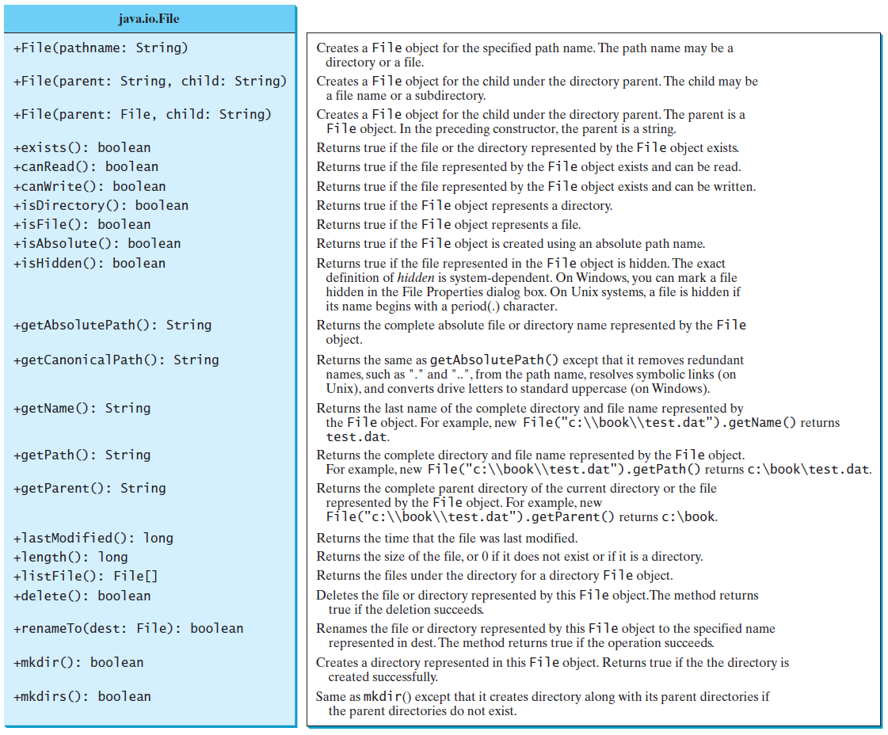
Obtaining file properties and manipulating file

Slide 5
Problem: Explore File Properties
Create a file test.txt on your Desktop.
public static void main(String[] args){
java.io.File file = new java.io.File("C:\\Users\\ankur\\Desktop\\test.txt");
System.out.println("Does it exist? " + file.exists());
System.out.println("The file has " + file.length() + " bytes");
System.out.println("Can it be read? " + file.canRead());
System.out.println("Can it be written? " + file.canWrite());
System.out.println("Is it a directory? " + file.isDirectory());
System.out.println("Is it a file? " + file.isFile());
System.out.println("Is it hidden? " + file.isHidden());
System.out.println("Absolute path is " + file.getAbsolutePath());
System.out.println("Last modified on " + new java.util.Date(file.lastModified()));
java.io.File file1 = new java.io.File("C:\\Users\\ankur\\Desktop\\aa.txt");
boolean b = file.renameTo(file1);
file1.delete();
}

Slide 6
The File Class
The File class, however, does not contain methods for reading and writing file contents.
In order to read/write strings and numeric values from/to a text file, we will use the Scanner and PrintWriter classes.

Slide 7
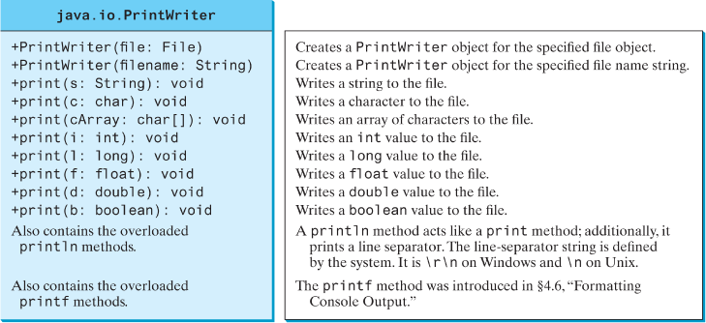
Writing Data Using PrintWriter

Slide 8
Writing Data Using PrintWriter
public static void main(String[] args) throws java.io.IOException {
java.io.File file = new java.io.File("C:\\Users\\ankur\\Desktop\\test.txt ");
java.io.PrintWriter output = new java.io.PrintWriter(file);
// Write formatted output to the file
output.print("John T Smith ");
output.println(90);
output.print("Eric K Jones ");
output.println(85);
// Close the file
output.close();
}

Slide 9
Writing Data – Avoid Overwrite
public static void main(String[] args) throws java.io.IOException {
java.io.File file = new java.io.File("C:\\Users\\ankur\\Desktop\\test.txt ");
if (file.exists()) { // To prevent overwriting existing file
System.out.println("File already exists");
System.exit(0);
}
java.io.PrintWriter output = new java.io.PrintWriter(file);
// Write formatted output to the file
output.print("John T Smith ");
output.println(90);
output.print("Eric K Jones ");
output.println(85);
// Close the file
output.close();
}

Slide 10
Appending data
If you need to append data, wrap the File object in the FileWriter object which in turn is wrapped in a PrintWriter object as shown below:
File file = new File("C:\\Users\\ankur\\Desktop\\test.txt");
FileWriter fw = new FileWriter(file, true); //true indicates append mode
PrintWriter output = new PrintWriter(fw);
output.print("John M Doe ");
output.println(70);
output.close();

Slide 11
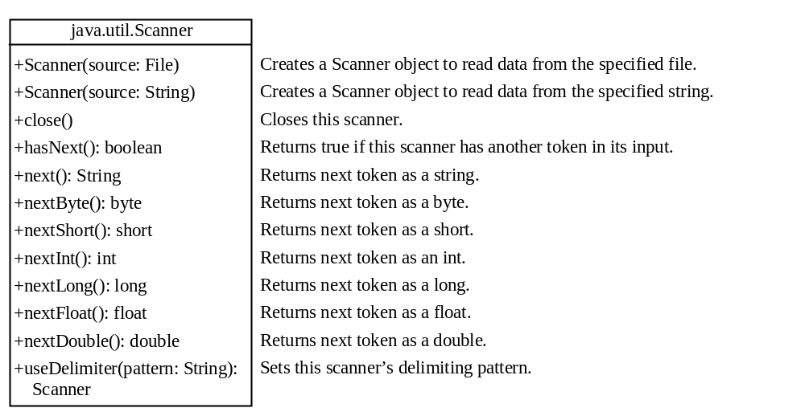
Reading Data Using Scanner

Slide 12
Reading Data Using Scanner
public static void main(String[] args) throws java.io.IOException {
// Create a File instance
java.io.File file = new java.io.File("C:\\Users\\ankur\\Desktop\\test.txt ");
// Create a Scanner for the file
Scanner input = new Scanner(file);
// Read data from a file
while (input.hasNext()) {
String firstName = input.next();
String mi = input.next();
String lastName = input.next();
int score = input.nextInt();
System.out.println(firstName + " " + mi + " " + lastName + " " + score);
}
// Close the file
input.close();
}

Slide 13
Exercise: Changing the Delimiter
// Program 1
String s = "Hello World Hello_World";
// create a new scanner with the specified String Object
java.util.Scanner scanner = new java.util.Scanner(s);
while(scanner.hasNext()){
System.out.println(scanner.next());
}
// close the scanner
scanner.close();
// Program 2
String s = "Hello World Hello_World";
// create a new scanner with the specified String Object
java.util.Scanner scanner = new java.util.Scanner(s);
// change the delimiter of this scanner to underscore plus space
scanner.useDelimiter("_| ");
while(scanner.hasNext()){
System.out.println(scanner.next());
}
// close the scanner
scanner.close();

